Slide 1
Outline
Computer Processing
Hardware Components
Networks
The Java Programming Language
Program Development
Object-Oriented Programming

Slide 2
Java
The Java programming language was created by Sun Microsystems, Inc.
It was introduced in 1995 and its popularity grew throughout the early 2000s.
A programming language specifies the words and symbols that we can use to write a program
A programming language employs a set of rules that dictate how the words and symbols can be put together to form valid program statements

Slide 3
Java Program Structure
In the Java programming language:
A program is made up of one or more classes
A class contains one or more methods
A method contains program statements
These terms will be explored in detail throughout the course
A Java application always contains a method called main
See Lincoln.java

Slide 4
//********************************************************************
// Lincoln.java Author: Lewis/Loftus
//
// Demonstrates the basic structure of a Java application.
//********************************************************************
public class Lincoln
{
// Prints a presidential quote.
public static void main(String[] args)
{
System.out.println("A quote by Abraham Lincoln:");
System.out.println("My best friend is a person who gives " + "me a book I have not yet read.");
}
}

Slide 5
//********************************************************************
// Lincoln.java Author: Lewis/Loftus
//
// Demonstrates the basic structure of a Java application.
//********************************************************************
public class Lincoln
{
// Prints a presidential quote.
public static void main(String[] args)
{
System.out.println("A quote by Abraham Lincoln:");
System.out.println("My best friend is a person who gives " +
"me a book I have not yet read.");
}
}
Output
A quote by Abraham Lincoln:
My best friend is a person who gives me a book I have not yet read.

Slide 6
Java Program Structure
// comments about the class
public class MyProgram
{
}
class header
class body
Note: Comments can be placed almost anywhere

Slide 7
Java Program Structure
// comments about the class
public class MyProgram
{
}
// comments about the method
public static void main (String[] args)
{
}
method header
method body

Slide 8
Comments
Comments should be included to explain the purpose of the program and describe processing steps
They do not affect how a program works
Java comments can take three forms:
// this comment runs to the end of the line
/* this comment runs to the terminating
symbol, even across line breaks */
/** this is a javadoc comment **/

Slide 9
Identifiers
Identifiers are the "words" in a program
A Java identifier can be made up of letters, digits, the underscore character ( _ ), and the dollar sign
Identifiers cannot begin with a digit
Java is case sensitive: Total, total, and TOTAL are different identifiers
By convention, programmers use different case styles for different types of identifiers, such as
title case for class names - Lincoln
upper case for constants - MAXIMUM

Slide 10
Identifiers
Sometimes the programmer chooses the identifer(such as Lincoln)
Sometimes we are using another programmer's code, so we use the identifiers that he or she chose (such as println)
Often we use special identifiers called reserved words that already have a predefined meaning in the language
A reserved word cannot be used in any other way

Slide 11
Reserved Words
The Java reserved words:
abstract
assert
boolean
break
byte
case
catch
char
class
const
continue
default
do
double
else
enum
extends
false
final
finally
float
for
goto
if
implements
import
instanceof
int
interface
long
native
new
null
package
private
protected
public
return
short
static
strictfp
super
switch
synchronized
this
throw
throws
transient
true
try
void
volatile
while

Slide 12
Quick Check
Which of the following are valid Java identifiers?
1 grade
2 quizGrade
3 NetworkConnection
4 frame2
5 3rdTestScore
6 MAXIMUM
7 MIN_CAPACITY
8 student#
9 Shelves1&2

Slide 13
Quick Check
Which of the following are valid Java identifiers?
grade
quizGrade
NetworkConnection
frame2
3rdTestScore
MAXIMUM
MIN_CAPACITY
student#
Shelves1&2
Valid
Valid
Valid
Valid
Invalid
Valid
Valid
Invalid
Invalid

Slide 14
Quick Check
Which of the following are valid Java identifiers?
grade
quizGrade
NetworkConnection
frame2
3rdTestScore
MAXIMUM
MIN_CAPACITY
student#
Shelves1&2
Valid
Valid
Valid
Valid
Invalid – cannot begin with a digit
Valid
Valid
Invalid – cannot contain the '#' character
Invalid – cannot contain the '&' character

Slide 15
White Space
Spaces, blank lines, and tabs are called white space
White space is used to separate words and symbols in a program
Extra white space is ignored
A valid Java program can be formatted many ways
Programs should be formatted to enhance readability, using consistent indentation

Slide 16
Outline
Computer Processing
Hardware Components
Networks
The Java Programming Language
Program Development
Object-Oriented Programming

Slide 17
Program Development
The mechanics of developing a program include several activities:
writing the program in a specific programming language (such as Java)
translating the program into a form that the computer can execute
investigating and fixing various types of errors that can occur
Software tools can be used to help with all parts of this process

Slide 18
Language Levels
There are four programming language levels:
machine language
assembly language
high-level language
fourth-generation language
Each type of CPU has its own specific machine language
The other levels were created to make it easier for a human being to read and write programs

Slide 19
Programming Languages
Each type of CPU executes only a particular machine language
A program must be translated into machine language before it can be executed
A compiler is a software tool which translates source code into a specific target language
Sometimes, that target language is the machine language for a particular CPU type
The Java approach is somewhat different.

Slide 20
Java Translation (IMPORTANT!)
The Java compiler translates Java source code into an intermediate representation called bytecode
Java bytecode is not the machine language for any traditional CPU
Bytecode is executed by the Java Virtual Machine (JVM)
Therefore Java bytecode is not tied to any particular machine.
Java is considered to be architecture-neutral.

Slide 21
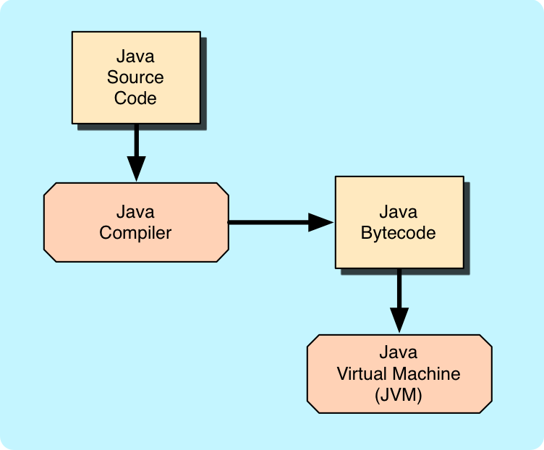
Java Translation

Slide 22
Development Environments
There are many programs that support the development of Java software, including:
Java Development Kit (JDK)
Eclipse
NetBeans
BlueJ
jGRASP
Though the details of these environments differ, the basic compilation and execution process is fundamentally the same.

Slide 23
Syntax and Semantics
The syntax rules of a language define how we can put together symbols, reserved words, and identifiers to make a valid program
The semantics of a program statement define what that statement means (its purpose or role in a program)
A program that is syntactically correct is not necessarily logically (semantically) correct
A program will always do what we tell it to do, not what we meant to tell it to do

Slide 24
Errors
A program can have three types of errors
The compiler will find syntax errors and other basic problems (compile-time errors)
If compile-time errors exist, an executable version of the program is not created (in the case of Java, bytecode)
A problem can occur during program execution, such as trying to divide by zero, which causes a program to terminate abnormally (run-time errors)
A program may run, but produce incorrect results, perhaps using an incorrect formula (logical errors)

Slide 25
Basic Program Development
Edit and
save program
errors?
Compile program
errors?
Execute program and
evaluate results

Slide 26
Outline
Computer Processing
Hardware Components
Networks
The Java Programming Language
Program Development
Object-Oriented Programming

Slide 27
Problem Solving
The purpose of writing a program is to solve a problem
Solving a problem consists of multiple activities:
Understand the problem
Design a solution
Consider alternatives and refine the solution
Implement the solution
Test the solution
These activities are not purely linear – they overlap and interact

Slide 28
Problem Solving
The key to designing a solution is breaking it down into manageable pieces
When writing software, we design separate pieces that are responsible for certain parts of the solution
An object-oriented approach lends itself to this kind of solution decomposition
We will dissect our solutions into pieces called objects and classes

Slide 29
Object-Oriented Programming
Java is an object-oriented programming language
As the term implies, an object is a fundamental entity in a Java program
Objects can be used effectively to represent real-world entities
For instance, an object might represent a particular department in a company
Each department object handles the processing and data management related to its real-world entity (ex: a HR department will have different responsibilities than an IT department)

Slide 30
Objects
An object has:
state - descriptive characteristics
behaviors - what it can do (or what can be done to it)
The state of a bank account includes its account number and its current balance
The behaviors associated with a bank account include the ability to make deposits and withdrawals
Note that the behavior of an object might change its state

Slide 31
Classes
An object is defined by a class
A class is said to be the blueprint of an object
The class uses methods to define the behaviors of the object
The class that contains the main method of a Java program represents the entire program
A class represents a concept, and an object represents the embodiment of that concept
Multiple objects can be created from the same class

Slide 32
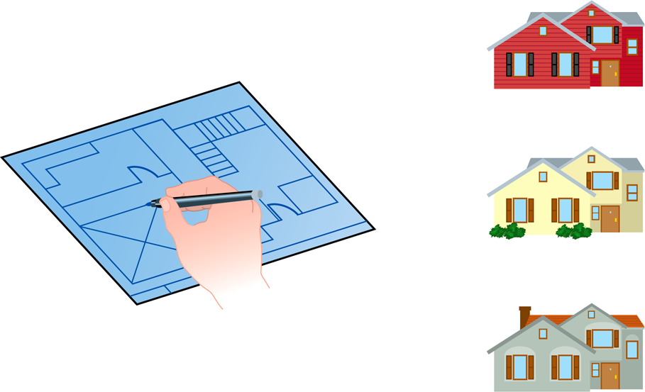
Class = Blueprint, Object = Entity
One blueprint to create several similar, but different, houses:
Class
Object

Slide 33
Objects and Classes
An object
(the realization)
An individual class
(the concept)
John’s Bank Account
Balance: $5,257
Bank Account
Bill’s Bank Account
Balance: $1,245,069
Multiple objects
from the same class
Mary’s Bank Account
Balance: $16,833

Slide 34
Inheritance
One class can be used to derive another via inheritance
Classes can be organized into hierarchies
Account
Charge Account
Bank Account
Savings Account
Checking Account

Slide 35
Summary
Chapter 1 focused on:
components of a computer
how those components interact
how computers store and manipulate information
computer networks
the Internet and the World Wide Web
programming and programming languages
an introduction to Java
an overview of object-oriented concepts

